Slide 1
Chapter 28
Amplifier Basics

Slide 2
Objectives
After completing this chapter, you will be able to:
  Describe the purpose of an amplifier
  Identify the three basic configurations of transistor amplifier circuits
  Identify the classes of amplifiers

Slide 3
Objectives (cont’d.)
  Describe the operation of direct coupled amplifiers, audio amplifiers, video amplifiers, RF amplifiers, IF amplifiers, and operational amplifiers
  Draw and label schematic diagrams for the different types of amplifier circuits

Slide 4
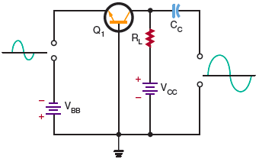
Amplifier Configurations
Figure 28-1. Common-base amplifier circuit.

Slide 5
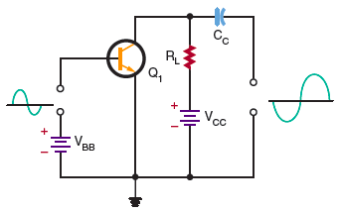
Amplifier Configurations
(cont’d.)
Figure 28-2. Common-emitter amplifier circuit.

Slide 6
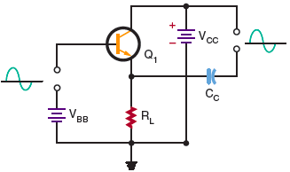
Amplifier Configurations
(cont’d.)
Figure 28-3. Common-collector amplifier circuit.

Slide 7
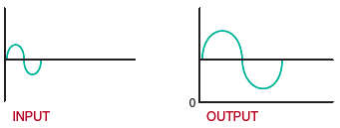
Amplifier Biasing
Figure 28-12. Class A amplifier output.

Slide 8
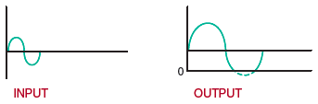
Amplifier Biasing (cont’d.)
Figure 28-13. Class AB amplifier output.

Slide 9
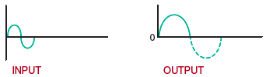
Amplifier Biasing (cont’d.)
Figure 28-14. Class B amplifier output.

Slide 10
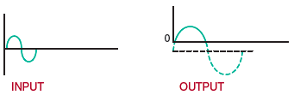
Amplifier Biasing (cont’d.)
Figure 28-15. Class C amplifier output.

Slide 11
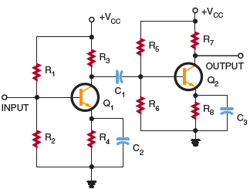
Amplifier Coupling
Figure 28-17. RC coupling.

Slide 12
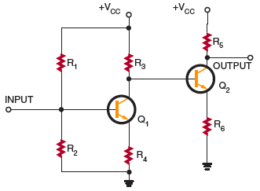
Amplifier Coupling (cont’d.)
Figure 28-20. Direct coupling.

Slide 13
Summary
Amplifiers are electronic circuits used to increase the amplitude of an electronic signal
The transistor is used primarily as an amplifying device
Three transistor amplifier configurations
  Common base, common collector, and common emitter

Slide 14
Summary (cont’d.)
Coupling methods used to connect one transistor to another
  Resistance-capacitance coupling, impedance coupling, transformer coupling, and direct coupling
Direct-coupled amplifiers are used for high gain at low frequencies or amplification of a DC signal

